Slide 1

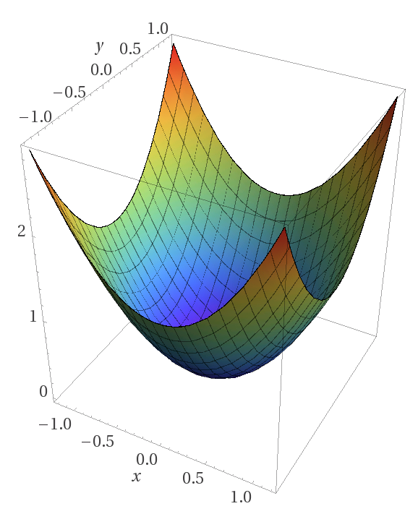
PhD Pre-Confirmation Meeting
Day Month 2019
Peter Donnelly
peter.donnelly@petermac.org
Illustrating Convex Optimization, the mathematical basis of neural networks
Image: https://www.matroid.com/blog/post/the-hard-thing-about-deep-learning
Notes:
This is a talk about what we are doing at Peter Mac to move high throughput sequencing into the clinical pathology area.
We’ve built a web application called Path-OS (for pathology operating system) to manage our variants.
In contrast to a lot of the talks in this forum it’s a bit more focused on software engineering than bioinformatics.

Slide 2

“Improving Classification of T-Cell Lymphomas By Applying Neural Networks to Heterogeneous Data Sources"

Slide 3
Problem Statement
Current Situation:
  Even experienced pathologists can find it challenging to differentiate some cancer types morphologically; Peripheral T-cell lymphomas (PTCL) as a particular example [1]
  Machine Learning has shown early promise in classifying oncology images but most current efforts focus on low hanging fruit; viz, easier to classify cancers where good labelled data happens to be available [2]
  Obtaining good results with ML critically depends on the availability of high quality, consistently labelled data to use for training, but such data is scarce. Therefore, techniques which reduce the amount of labelled data required to achieve a given level of result are of great practical interest

Slide 4
Questions Which Thesis Will Attempt to Answer
Primary Questions
  Could a suitably selected and appropriately applied ML technique differentiate cancer types which human pathologists find challenging to visually differenate?
    Specifically, Non-Hodgkins T-cell lymphomas
  Could the use of Multi-modal ML with two orthogonal data types make for improved classification over either alone?
    Specifically, morphology + gene expression data over morphology alone
Secondary Question:
  Could using two orthogonal data types reduce the number of labelled examples necessary to achieve the same level of classification compared to data alone?

Slide 5
Proposed Thesis
"Improving Classification of T-Cell Lymphomas By Applying Neural Networks to Heterogeneous Data Sources"
Aim 1
  (Q1) Test efficacy of ML classification of T-Cell Lymphomas using WSI image data alone & Gene Expression data alone (RNASeq or Nanostring data)
Aim 2
  (Q2, Q3) Test efficacy of Multi-Modal ML classification of T-Cell Lymphomas using both WSI Image data and Gene Expression data
Wednesday, 2 October 2019
HUB Path-OS
Notes:
So these are some of the issues with most current molecular pathology services.
Things are likely to get more complex as more is learned about disease pathology and epigenetics gets used.
It really comes down to a data filtering exercise, processing the variants and evidence in a clinically usable timeframe.

Slide 6
Motivating Papers
‘Classification and Mutation Prediction from Non-Small Cell Lung Cancer Histopathology Images using Deep Learning’
  Illustrating the clinical challenge
‘Clinical-grade computational pathology using weakly supervised deep learning on whole slide images’
  Showing that ML can achieve ‘Clinical Grade’ results for WSI cancer classification
  Showing that one ML model can classify multiple cancer types (H&E images)
  Illustrating the effectiveness of Multiple Instance Learning for tiled WSIs
‘Utilizing Automated Breast Cancer Detection to Identify Spatial Distributions of Tumor Infiltrating Lymphocytes in Invasive Breast Cancer’
  Illustrating respectable results from applying ML to WSI images
  Illustrating at least one system (‘pipeline’) level approach
‘Classification and Mutation Prediction from Non-Small Cell Lung Cancer Histopathology Images using Deep Learning’
  Illustrating a ‘low hanging fruit’ application of ML to WSI Image Classification
  Showing respectable results from an ‘off the shelf’ ML model (Google Inception v3)
‘Machine Learning and Knowledge Extraction in Digital Pathology Needs an Integrative Approach’
  Suggesting that a Multi-Model approach would be highly desirable

Slide 7
Classification and Mutation Prediction from Non-Small Cell Lung Cancer Histopathology Images using Deep Learning

Slide 8

Staging

Slide 9
Methods
Techniques:
  Contemporary Neural Networks (supervised learning)
  Multi-modal Learning (orthogonal data types)
  Multiple Instance Learning
  Data Sharding
  One-at-a time cross validation
Particular Algorithms:
  Deep Convolutional Neural Networks
  LSTM Recurrent Neural Networks
  Transformer Networks (cf. Google Brain)
  Hybrid Learning Networks (custom combinations of the above)
Metrics
  Precision/Recall/F-score/ROC (Receiver Operating Characteristic) performance against held-back data

Slide 10
Data Sources

Slide 11
Issues & Risks
Availability of sufficient quantities of suitable labelled data to use for training
  Permissions
  Quality of labels (classifications)
  Volume
It is unknown whether an ML algorithm will be able to extract sufficient signal from morphological features to combine with gene expression data

Slide 12
Chapters

Slide 13
More slides

Slide 14
Context and Motivation
Machine Learning making explosive progress since about 2012
  A Key Event: AlexNet 2012
  Why? Alignment of planets
    Hardware power & suitability of GPUs for parallelizing ML processing (Linear Algebra)
    Refinements to longstanding algoirthms eg. ReLu, Regularization …
ML is emerging as universal tool
  Every discipline / profession / research field is looking to see what ML might to for them
  Including essentially every medical field …
    Used clinically in only a small number of applications – e.g. detecting glaucoma
  … and oncology in particular
    But still very much pre-clinical
ML holds great promise for oncology
  Many important oncology problems are classification problems, and ML is good at this
  Current practice are highly manual and time consuming and require much judgment
  ML models are accretive & once developed can be disseminated at very low cost
But there are significant challenges
  Not yet known which applications are a good match
  Lack of quality labeled data is a hindrance
  Skill chasm: ML researchers know little about oncology and vice-versa
    Emergence of bioinformatics as a specialized category
    Modern genomics brought IT and big data skills with it, so base of expertise exists
Wednesday, 2 October 2019
HUB Path-OS
Notes:
So these are some of the issues with most current molecular pathology services.
Things are likely to get more complex as more is learned about disease pathology and epigenetics gets used.
It really comes down to a data filtering exercise, processing the variants and evidence in a clinically usable timeframe.

Slide 15
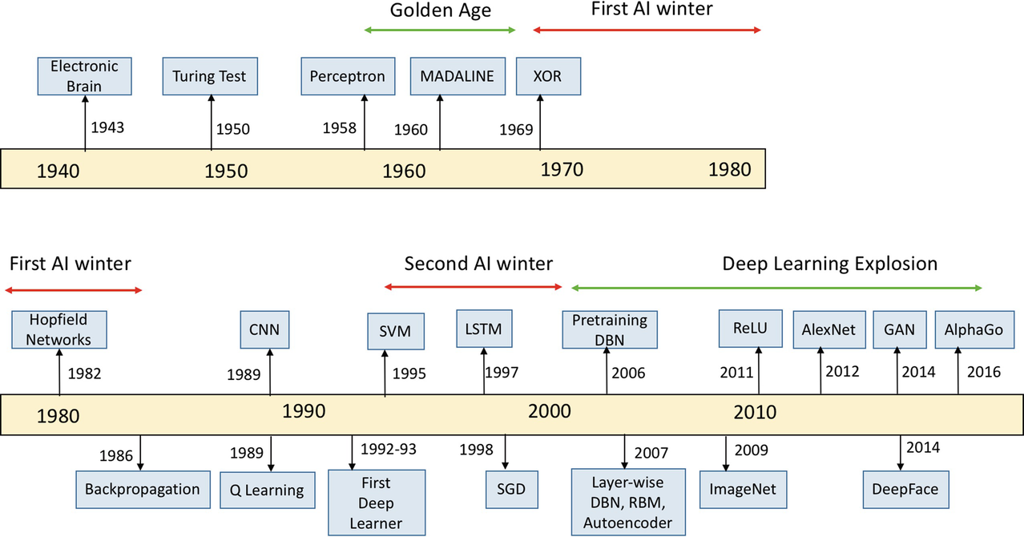
Capsule History of AI
Source: Kamath U., Liu J., Whitaker J. (2019) Introduction. In: Deep Learning for NLP and Speech Recognition. Springer.

Slide 16
My Work to Date
Acquiring Relevant Domain Knowledge
  Cell biology and cancer genomics (reading and lectures)
  Cancer Pathology Processes
    Learing about PMCC roles, workflows and systems
    Gene Sequencing & Curation (reading, interviews, lectures)
  Histopathology (reading and lectures)
Establishing and methodically using reference management system (Zotero based)
ML Infrastructure
  Home Environment: for learning and rapid model development / tweaking
  AWS (Cloud) P3 Spot Instances: for large scale learning
  PMCC ML facility
Deep Dives into relevant contemporary ML algorithms, models, techniques including
  Convolutional Neural Networks
  Long Short Term Memory (LSTM) RNN networks and Attention Models
  Transformer Models, in particular Google Brain’s Tensor2Tensor implementation
  Word Embedding (eg. Word2Vec, Glove …)
Trying out and existing relevant ML applications
  Text Summarization using LSTM (model: ‘Long-Summarization’)
  Analysis of cancer pathology samples using CNN (‘QUIP’)
  Text2Text applications using Transformer models (Google Brain‘Tensor2Tensor)
Locating and experimenting with useful tools and datasets
  digitally accessible portions of the literature (PubMed Central)
  well known & best practice datasets (e.g. disease, gene and drug ontologies)…
Circumscribing and homing in on a tractable problem (subsequent slides)
  Relevant, Achievable, Interesting, Reasonable likelihood of success
Wednesday, 2 October 2019
HUB Path-OS
Notes:
So these are some of the issues with most current molecular pathology services.
Things are likely to get more complex as more is learned about disease pathology and epigenetics gets used.
It really comes down to a data filtering exercise, processing the variants and evidence in a clinically usable timeframe.

Slide 17
Opportunity Areas & Assessments
Automated Histopathology Sample Analysis tool
  How: Using CNN or Captioning Model (Image to Text)
  Assessed Level of Innovation: Low if CNN; High if Captioning
  Notional Difficulty: Medium if CNN based; Medium if Captioning based
  Likelihood of Successful Outcome: Medium if CNN based; Unknown if Captioning based
Literature Summarizing Tool for Curators
  How: Using either LSTM or Transformer
  Assessed Level of Innovation: Low - Medium
  Notional Difficulty: High
  Likelihood of Successful Outcome: Low - Medium
Knowledge Extraction from the Literature
  How: Using techniques such as …
  Assessed Level of Innovation: Medium
  Notional Difficulty: Medium
  Likelihood of Successful Outcome: Medium
End-to-End Gene Curation using Captioning Model
  How: Captioning Model (Gene Sequence to Text)
  Assessed Level of Innovation: High
  Notional Difficulty: Unknown but probably High
  Likelihood of Successful Outcome: Unknown
Cancer Classification using orthogonal data sources (eg. gene sequence + blood test results)
  How: Multi-mode NN model (eg. CNN + LSTM)
  Assessed Level of Innovation: Medium
  Degree of Difficulty: High (hard to acquire the data)
  Likelihood of Successful Outcome: Unknown
Wednesday, 2 October 2019
HUB Path-OS
Notes:
So these are some of the issues with most current molecular pathology services.
Things are likely to get more complex as more is learned about disease pathology and epigenetics gets used.
It really comes down to a data filtering exercise, processing the variants and evidence in a clinically usable timeframe.

Slide 18
Notes:
Is it of any use to Piers and Yamuna
Actual proposed aims as opposed to theoretical aims
Validate that we can get data, or alternatively how can we get the data (who do we have to hassle)
Frame it very narrowly

